Slide 1


ENZ BOOK CLUB

Slide 2

ONLINE BOOK REVIEW SYSTEM
6. Sneha X
7. Tanmay G Mehta
8. Tatiparthi Bhargav Reddy
9. Vaishnavi Rajendra Donade
10.Vankireddy Chandana
1. Shete Nila Dhanraj
2. Shrutiprabha Dash
3. Sibananda Sahoo
4. Siripurapu Chandana
5. Sk Saud

Slide 3
ABSTRACT
Nobody likes to spend money on a new book only to face that overwhelming feeling of disappointment when it doesn't live up to your expectations.
The solution is to check our “ENZ BOOK CLUB” web application reviews before you hit the shop. The greater the diversity of opinions you can gather, the more confidence you can have that you'll enjoy the title.

Slide 4
INTRODUCTION
This “ENZ BOOK CLUB” objective is to design Book Review system, and to develop a customer web-based Review system.
The user can give the ratings and feedback to the books from their experiences.
Presence of book reviews can help validate the worthiness of a book and establish who the book’s audience is. Then once validated, other similar users are much more likely to want to join their peers and read that same book.

Slide 5
PROPOSED SYSTEM
The proposed “ENZ BOOK CLUB” web application which contains the reviews of the new books which are uploaded by the user .It will also help the user to know the latest books of their interest being introduced into the market like fiction, science, technology etc.

Slide 6
TECHNOLOGY USED
Spring boot
Type Script
Java
MySQL
Angular
HTML
CSS
JPA

Slide 7
ENVIRONMENT
Intel hardware machine (PC P4-2.26 GHz, 8GB RAM, 40 GB HDD)
Server – Apache Tomcat 8
Database – MySQL
MySQL Connector
Node Version 10
JDK 1.8
Eclipse IDE or Spring Tool Suite

Slide 8
What is Spring Boot?
Spring Boot provides a good platform for Java developers to develop
a stand-alone and production-grade spring application that you can
just run.
You can get started with minimum configurations without the need
for an entire Spring configuration setup. You can get started with
minimum configurations without the need for an entire Spring
configuration setup.

Slide 9
Goals
Spring Boot is designed with the following goals −
To avoid complex XML configuration in Spring
To develop a production ready Spring applications in an easier way
To reduce the development time and run the application
independently
Offer an easier way of getting started with the application

Slide 10
Advantages of spring boot
-
Spring Boot offers the following advantages to its developers −
Easy to understand and develop spring applications
Increases productivity
Reduces the development time.

Slide 11
Why Spring Boot?
It provides a flexible way to configure Java Beans, XML
configurations, and Database Transactions.
It provides a powerful batch processing and manages REST
endpoints.
In Spring Boot, everything is auto configured; no manual
configurations are needed.
Eases dependency management

Slide 12
How does it work?
You can choose Spring Boot because of the features and benefits it offers
as given here −
It provides a flexible way to configure Java Beans, XML configurations,
and Database Transactions.
It provides a powerful batch processing and manages REST endpoints.
In Spring Boot, everything is auto configured; no manual configurations
are needed.
It offers annotation-based spring application
Eases dependency management

Slide 13
What is Angular?
Angular is an open-source, JavaScript framework written in
TypeScript. Google maintains it, and its primary purpose is to
develop single-page applications.
As a framework, Angular has clear advantages while also
providing a standard structure for developers to work with.
It enables users to create large applications in a maintainable
manner.

Slide 14
Why do we need a framework?
Frameworks in general boost web development efficiency and
performance by providing a consistent structure so that developers
don’t have to keep rebuilding code from scratch.
Frameworks are time savers that offer developers a host of extra
features that can be added to software without requiring extra effort.

Slide 15
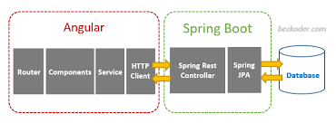

Slide 16
MODULES OF ENZ BOOK CLUB
Users Module: Used for managing the users of the system.
Admin Module: Used for managing the reviews details and user information.

Slide 17
E-R DIAGRAM FOR ADMIN

Slide 18
ER DIAGRAM FOR USER

Slide 19
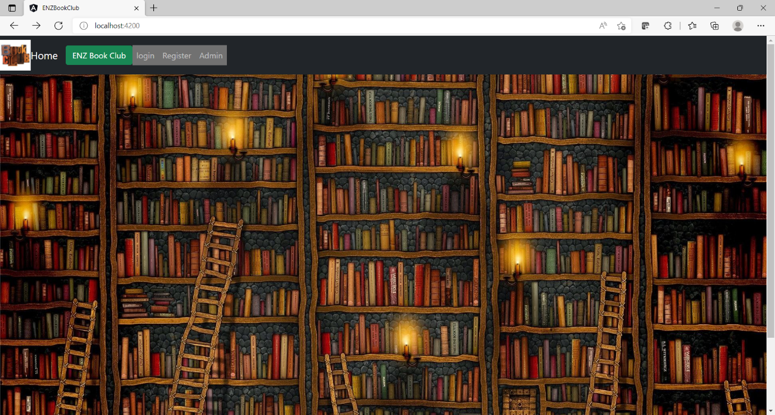
Dashboard

Slide 20
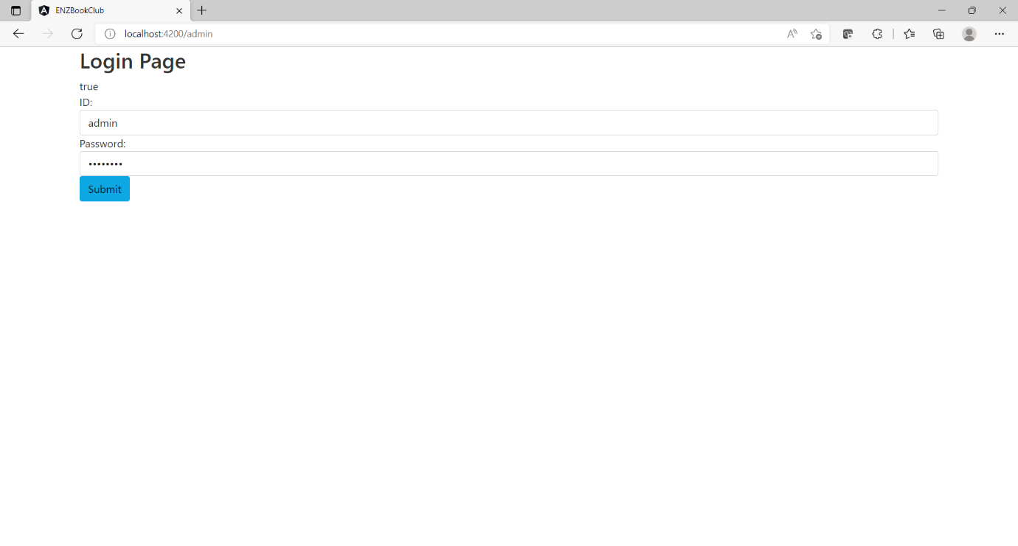
ADMIN LOGIN

Slide 21
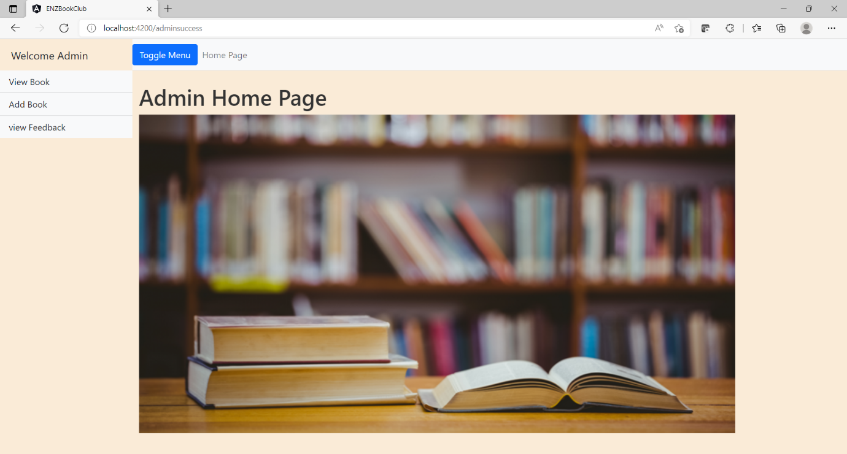
THE ADMIN HOME PAGE

Slide 22
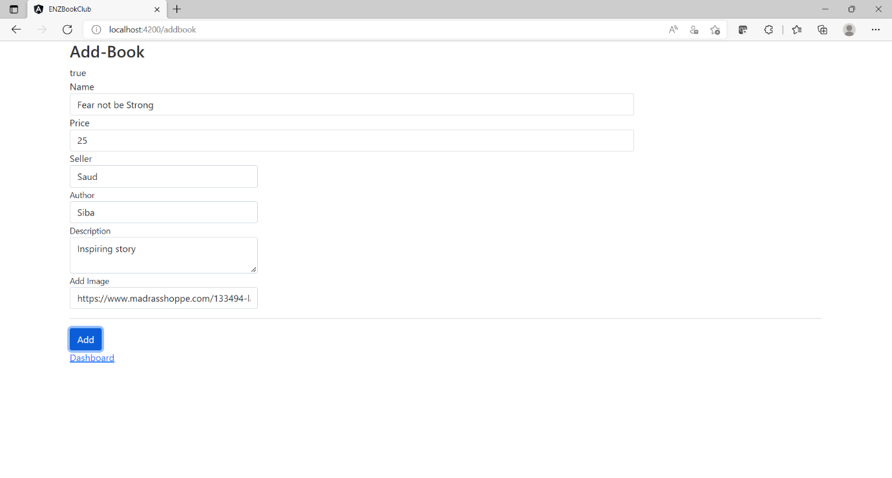
ADD BOOK

Slide 23
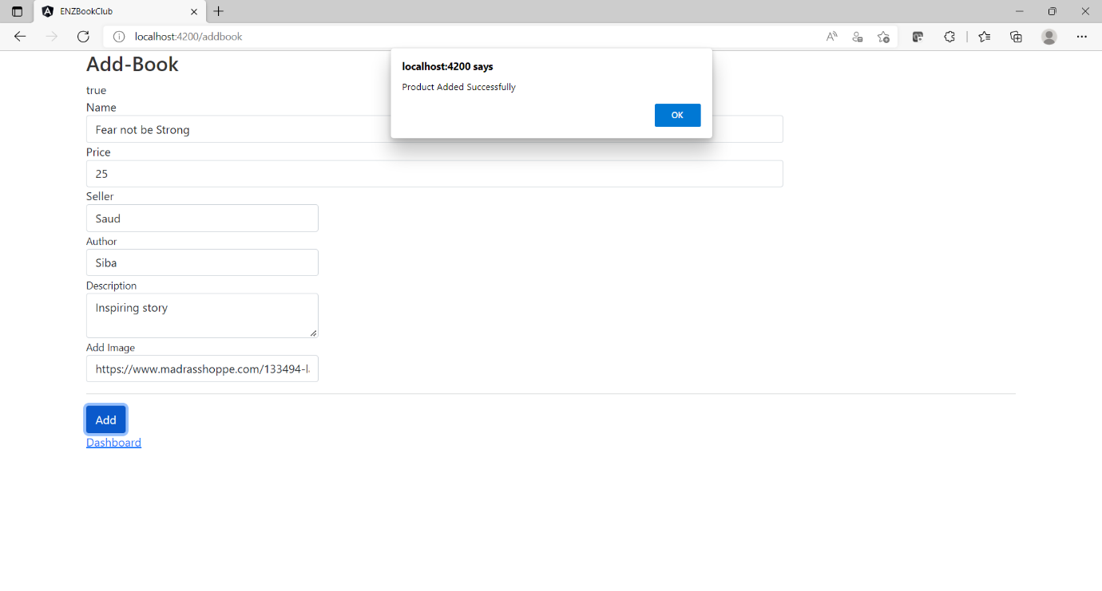
BOOK SUCCESSFULLY ADDED

Slide 24
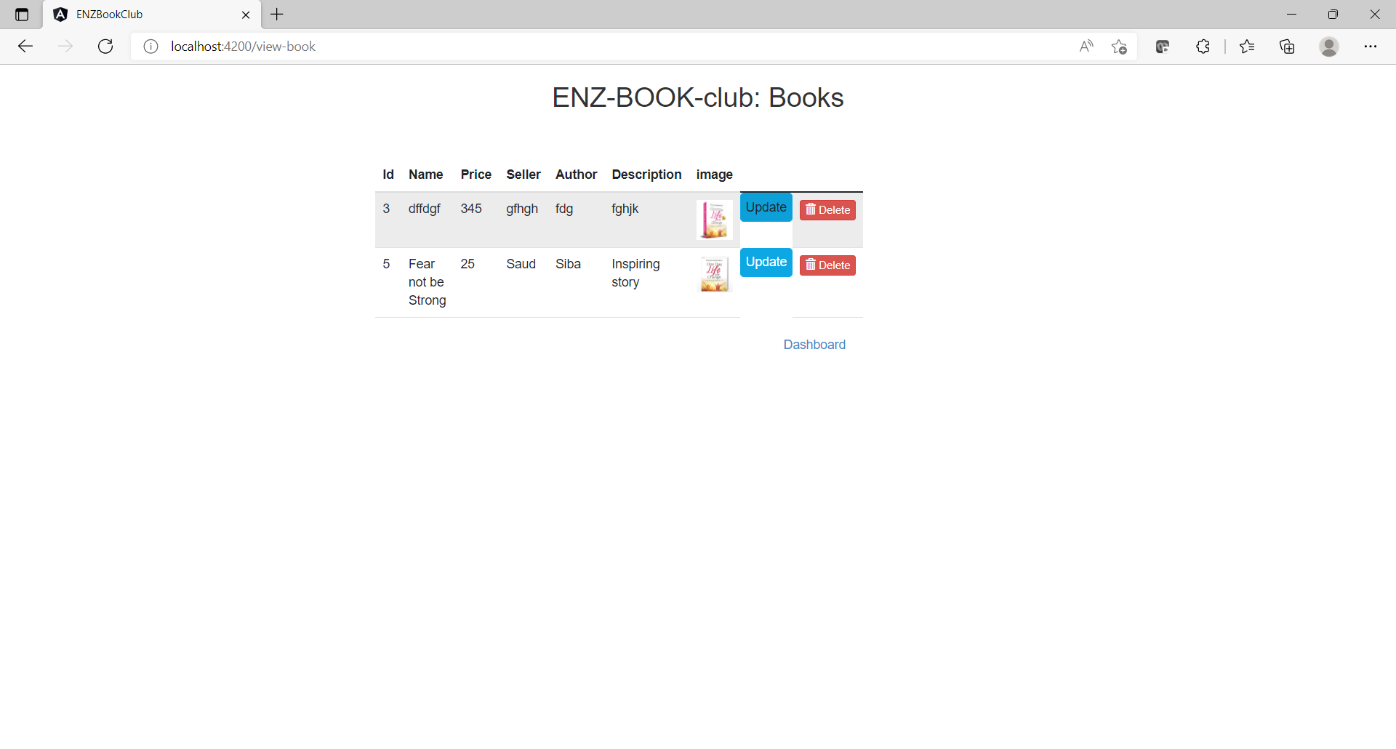
VIEW BOOK

Slide 25
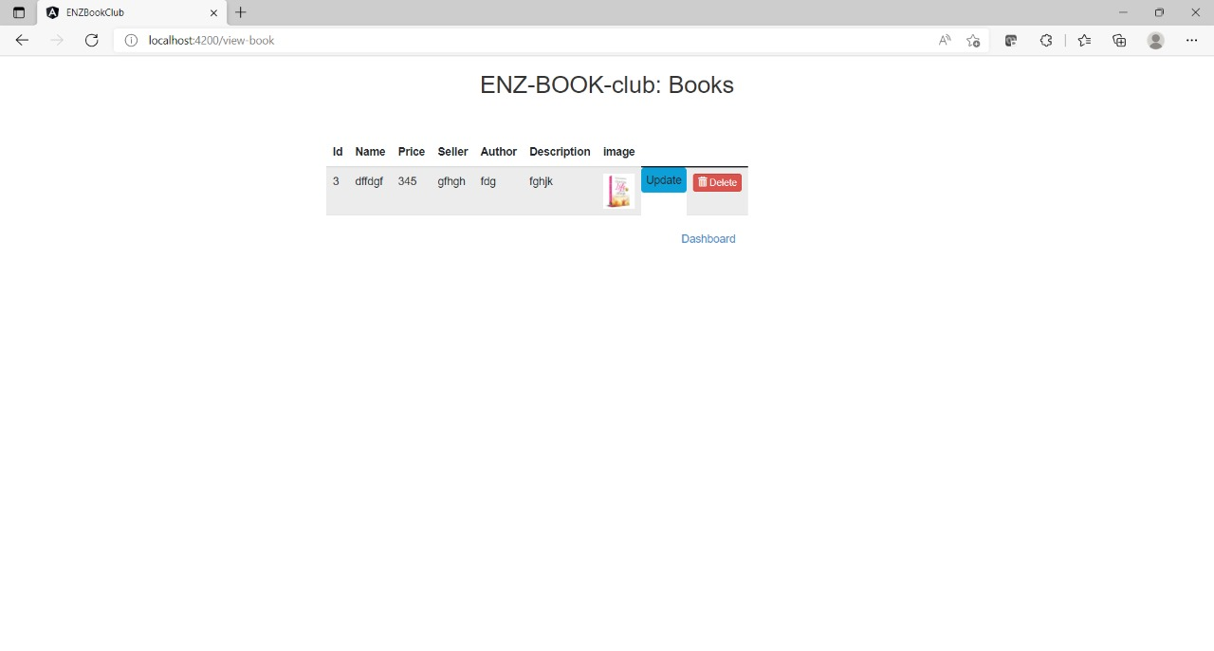
DELETE BOOK

Slide 26
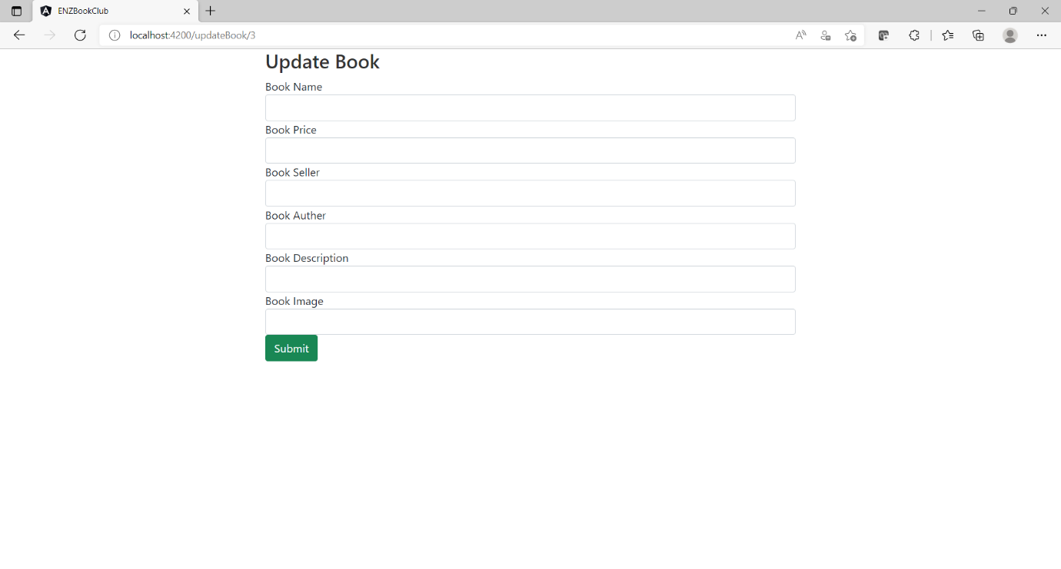
UPDATE BOOK

Slide 27
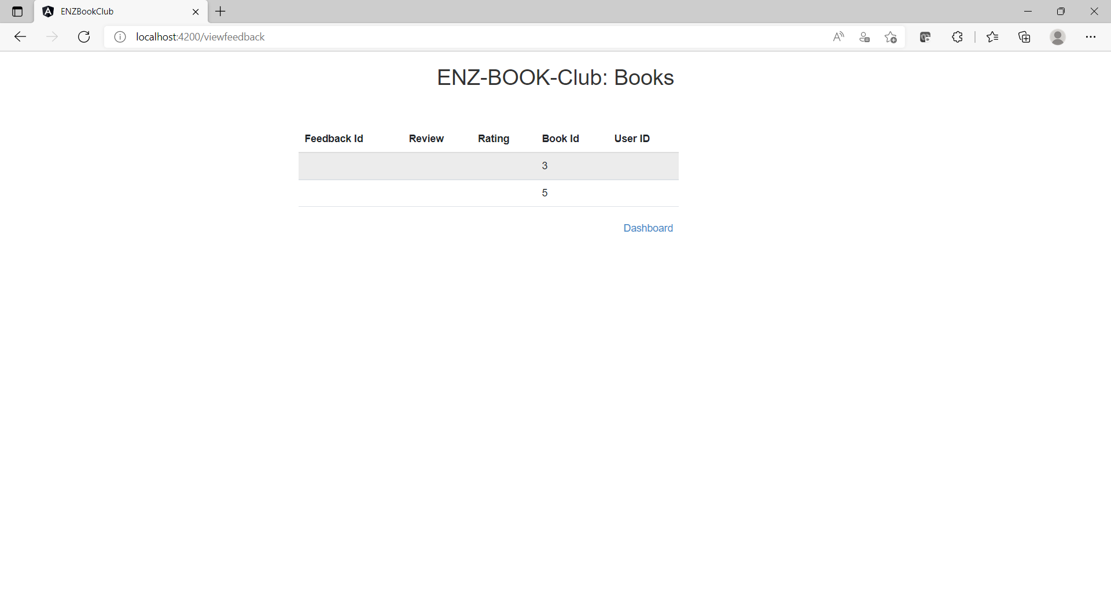
ADMIN FEEDBACK

Slide 28
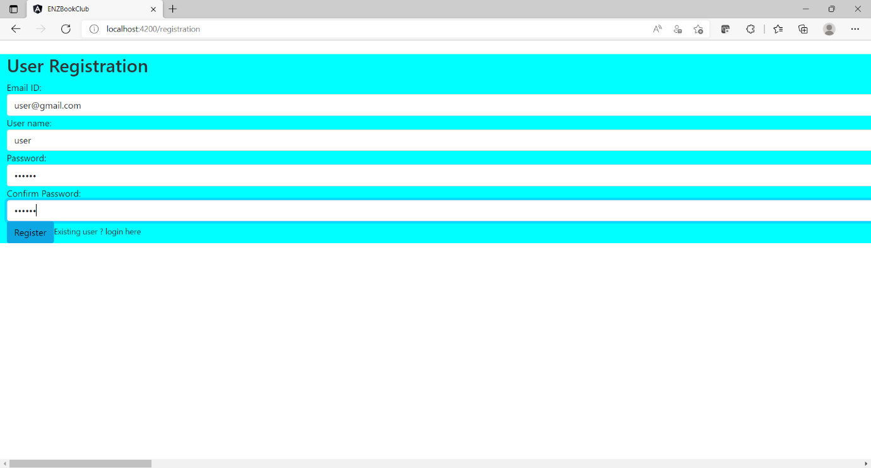
USER REGISTRATION

Slide 29
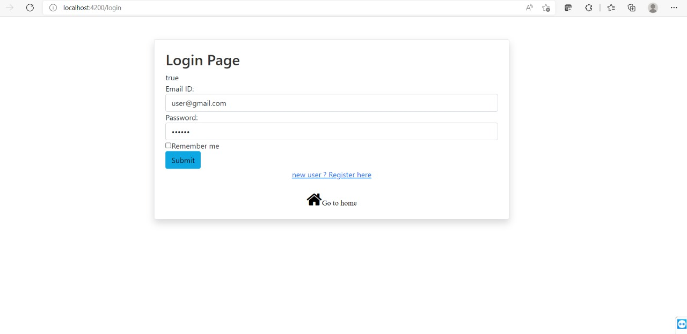
USER LOGIN

Slide 30
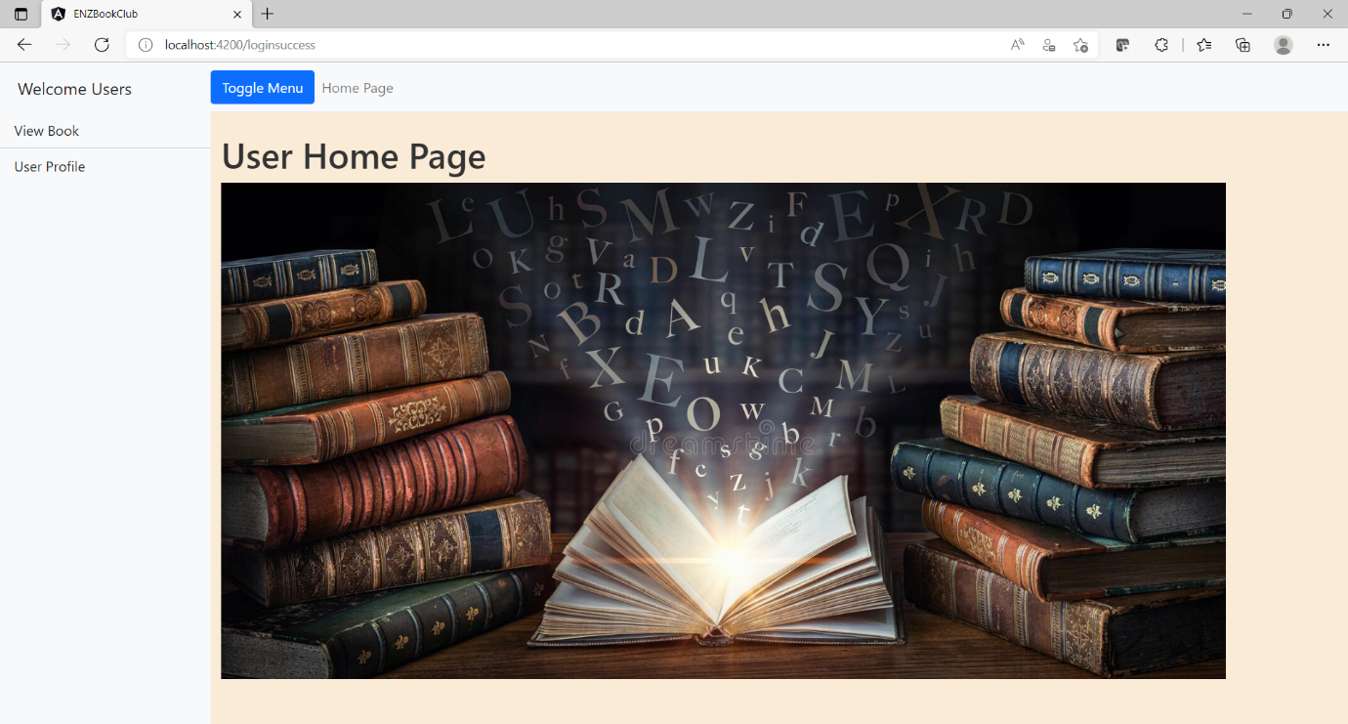
USER HOME PAGE

Slide 31
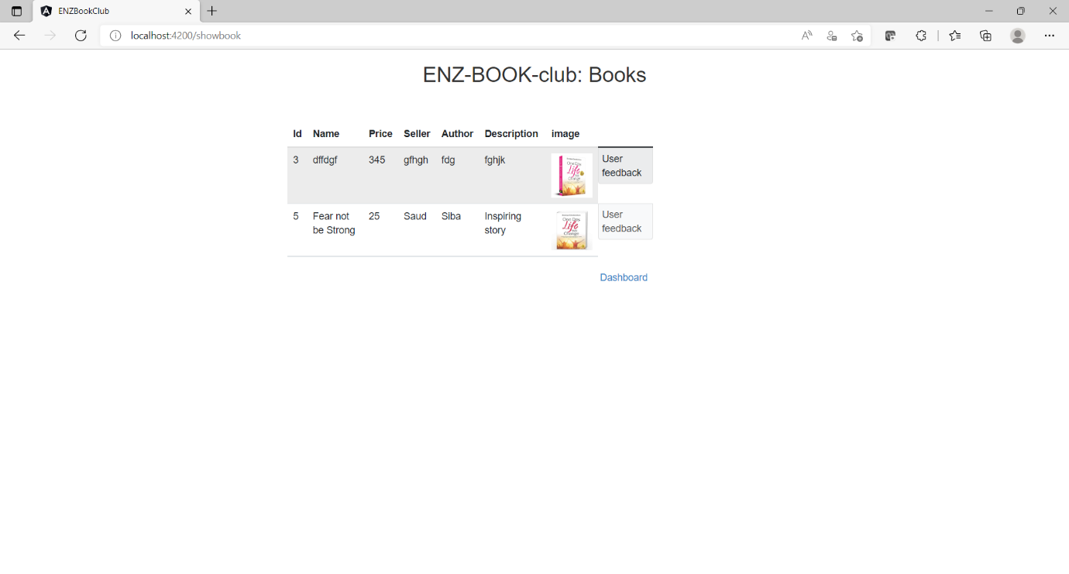
VIEW BOOK

Slide 32
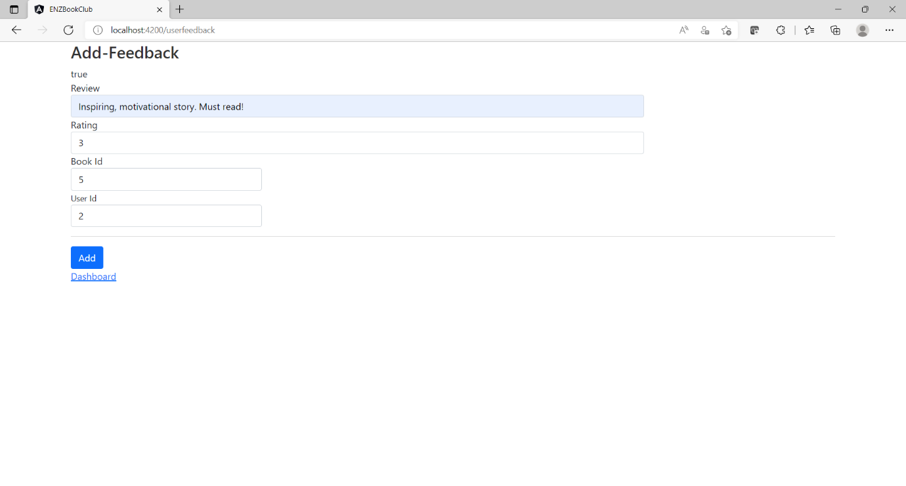
ADD FEEDBACK

Slide 33
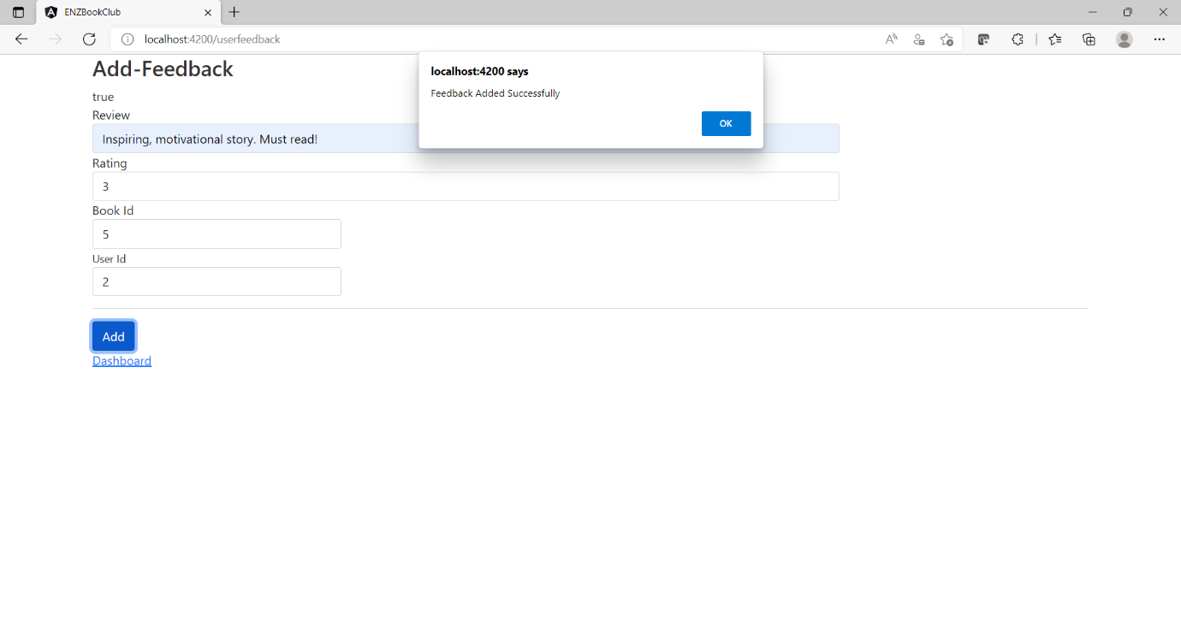
ADDED SUCCESSFULLY

Slide 34
ADVANTAGES
This gives books greater visibility and a greater chance of getting found by more readers.
User can view details of the books without going anywhere.
It is convenient for users as this system provides accurate cost and description of the system.
User can view different categories of books at a single place.
It helps people decide whether or not the book would interest them enough to read it.

Slide 35
UNIQUE SELLING POINTS
The Online Book review system can inculcate some new changes to benefits the Owner as well as Users.
The Book inventory can consist of all Genre Books, so it could attract many new users to express the experience on it.
The most positive feedback given to any book can be seen in Top of the Home page as soon as User Login’s.
Owner/Admin can also introduce new Authors with their Books and publish it for reviews which in return will give chance a to New Authors and hope of growing. Also Book inventory would have diversified collection of Books for users to review them.
B2C will increase in high ratio if the above USP is be taken into consideration and also User will be able to express their thoughts and new User upon the feedbacks would make their choice more easily to opt for new Books.

Slide 36
CONCLUSION
Our project is only a humble venture to satisfy the needs to manage their project work. Several user-friendly coding has also adopted.
The objective of software planning is to provide a frame work that enables the manger to make reasonable estimates made within a limited time frame at the beginning of the software project and should be updated regularly as the project progresses.
At the end it is concluded that we have made effort on following points.

Slide 37


